Slide 1
L1: power considerations AND ide basics
ESE516: IoT Edge Computing
Wednesday, January 23, 2019
Eduardo Garcia - edgarc@seas.upenn.edu

Slide 2
agenda
Bill of Materials (BOM) next steps -> Power
Tools to develop firmware in industry: Introduction to IDEs and HALs
Introduction to Atmel Studio 7 and ASF Lab
Good embedded coding practice #1 – Comments and Documentation with Doxygen – Moved to Monday 01/28/2019

Slide 3
BOM REVIEW

Slide 4
BOM REVIEW
Making a tentative BOM for an idea has the following benefits:
Answers, “Can a product be made with components on the market?”
If not, are we willing to do the components (plus R&D) ourselves?
Grounds us to reality
Is it feasible to take to market?
How much would it cost approximately?
Can we get the components needed? What is the market availability

Slide 5

Juicero
https://blog.bolt.io/heres-why-juicero-s-press-is-so-expensive-6add74594e50

Slide 6
BOM next steps - power
Making a tentative BOM allows us to answer a very important question for embedded devices (specially IoT):
How much power do we need?
This question determines:
Power source sizing
Can our preferred power source handle this power requirement?
How long does our product last when on?

Slide 7
BOM next steps - power
For next Monday (January 28th, 2019):
Power budget for device
Power architecture (Do we need a Buck and/or a boost converter? LDOs?
More detail in project deliverable document

Slide 8
Integrated Development Environment (IDE)

Slide 9
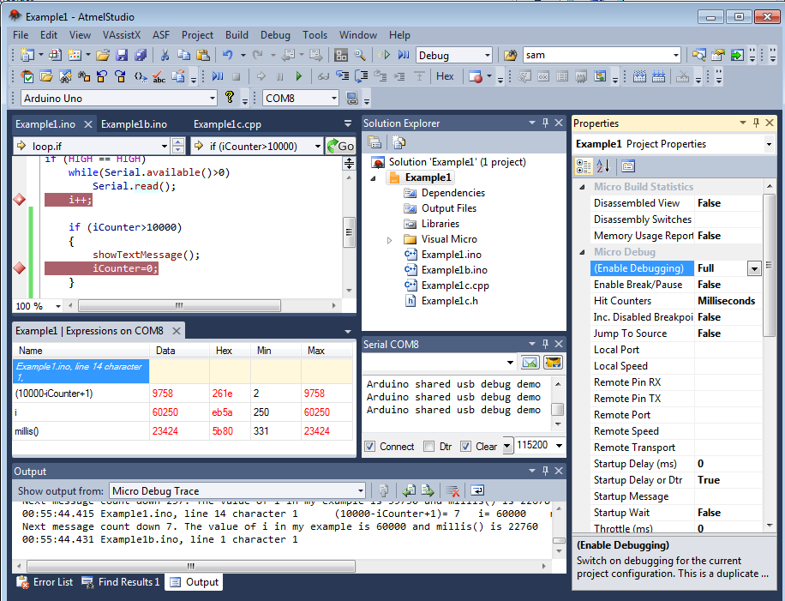
What’s an IDE?
Swiss army knife for development
Code Editor
Build automation tools
Debugging
Household names: Visual Studio, Eclipse, Xcode
Atmel Studio 7 is our choice
Free to use, built for our MCU
Only works with Atmel MCUs

Slide 10
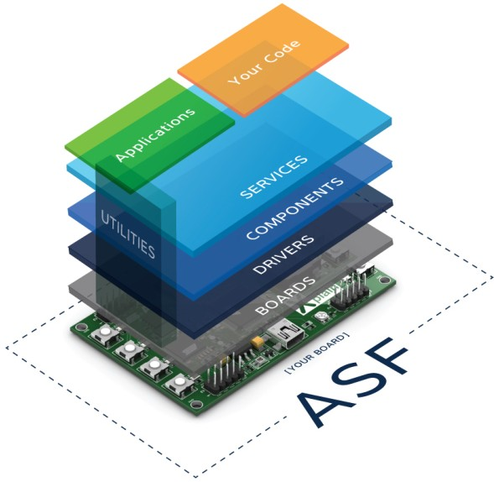
Why Atmel Studio?
Supports the SAM W25
Free, unlimited use
Atmel Studio Framework (ASF) – libraries baked into the IDE to simplify code development
Similar to Visual Studio
Comprehensive toolset – disassembler, variable watch, register display, debug breakpoints, etc.

Slide 11
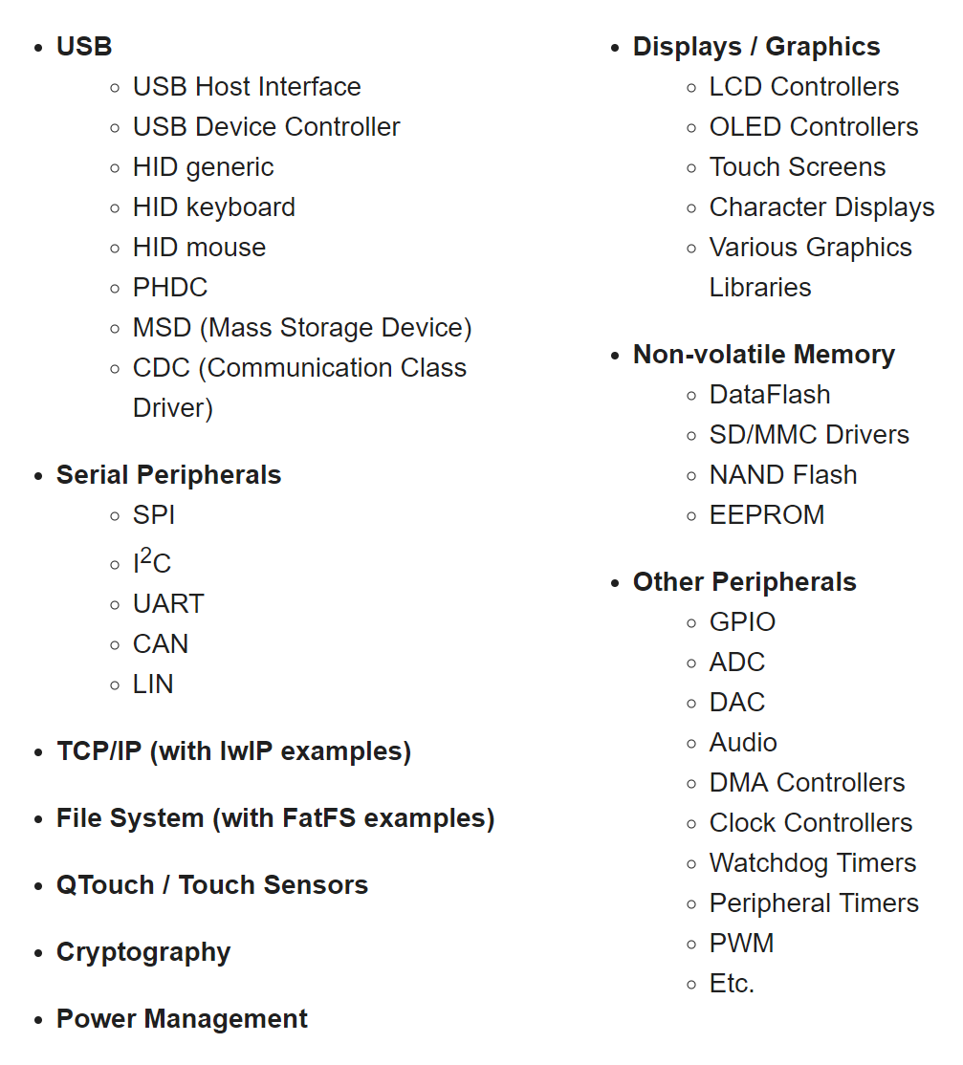
Atmel Studio Framework (ASF)
Stand on the shoulders of giants
Documentation and examples
Well vetted code (but there still can be errors!)
Built for ease of use in many scenarios – not the slimmest codebase

Slide 12
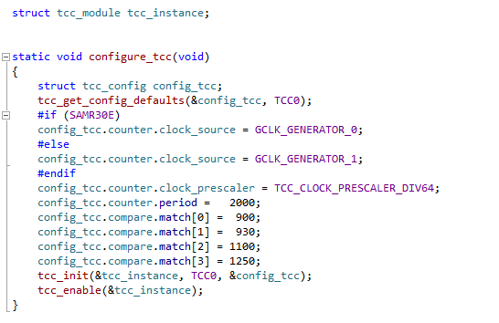
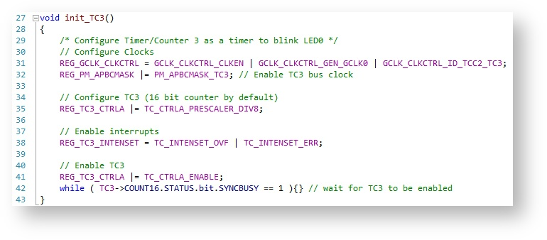
ASF vs direct register coding
Coding registers directly
Coding with a HAL (Atmel ASF)

Slide 13
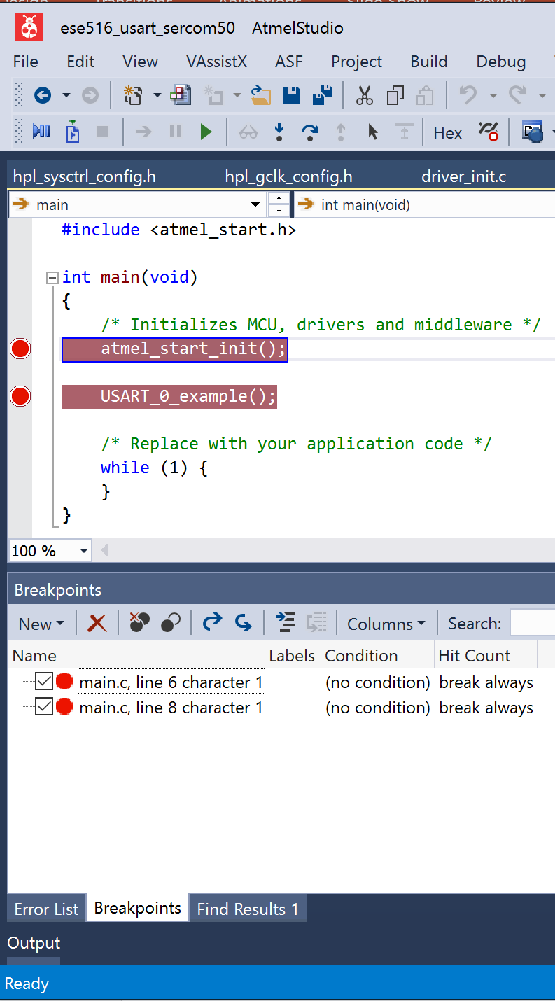
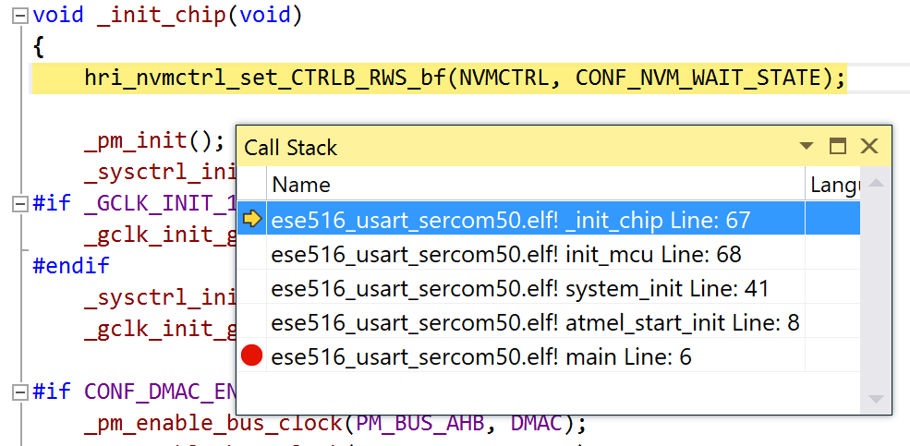
Scenario: Breakpoints
Your code is running fine until you press a button – then, it seems to hang.
You set a breakpoint at the button ISR, and follow from there.
Call stack provides an execution trail

Slide 14
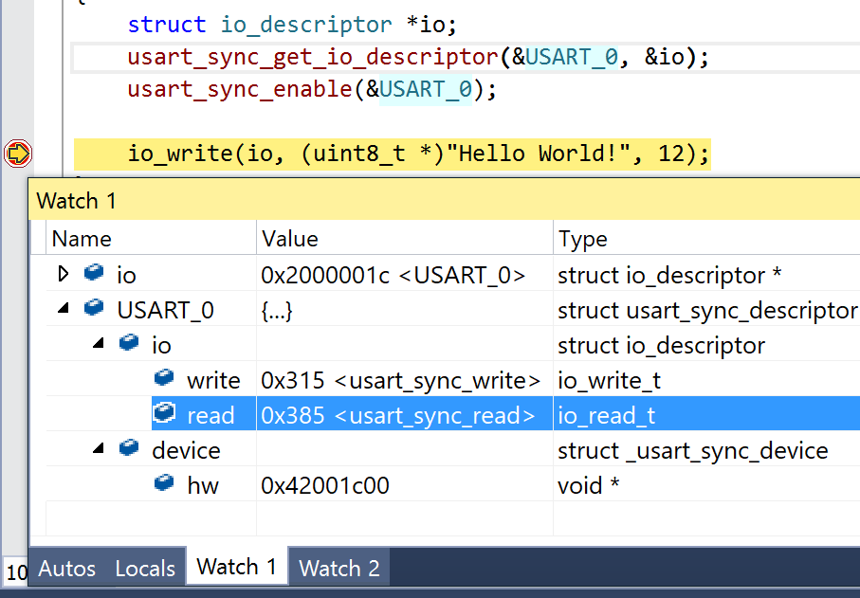
Scenario: Variable Watch
You’ve created a function that performs mathematics on two timestamps. However, it keeps giving you the wrong results.
After setting a breakpoint, you add a number of variables to your watch list. You realize that the timestamps were 32-bit, but the output was stored as 16-bit.

Slide 15
Pin Mapping

Slide 16
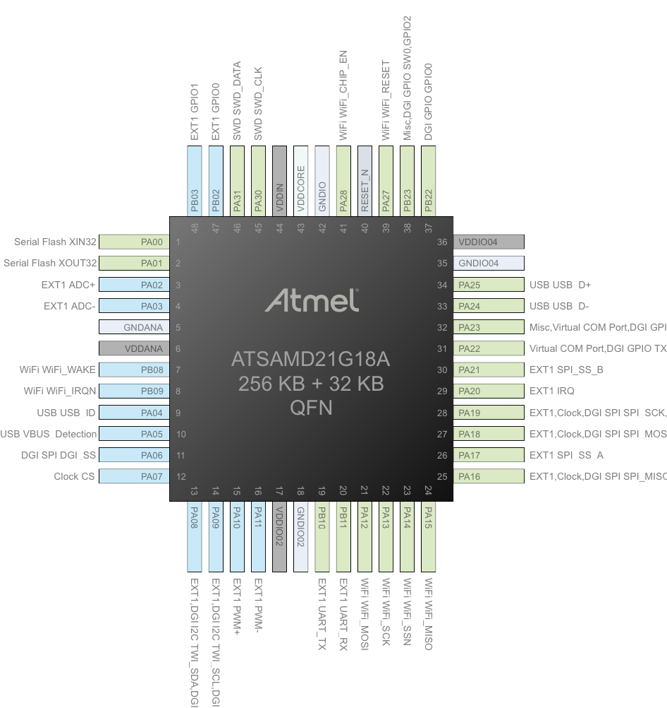
Pin Muxing: SERCOM
Atmel SAM (ARM) ICs have some flexibility in terms of pin mapping
SERCOM = SERial COMmunication
Supports SPI, USART, I2C
I2S not a part of this
6x SERCOM# available for use
Cannot reuse SERCOM numbers – for example is SERCOM0 is your USART debug, you cannot also use SERCOM0 as your I2C bus

Slide 17
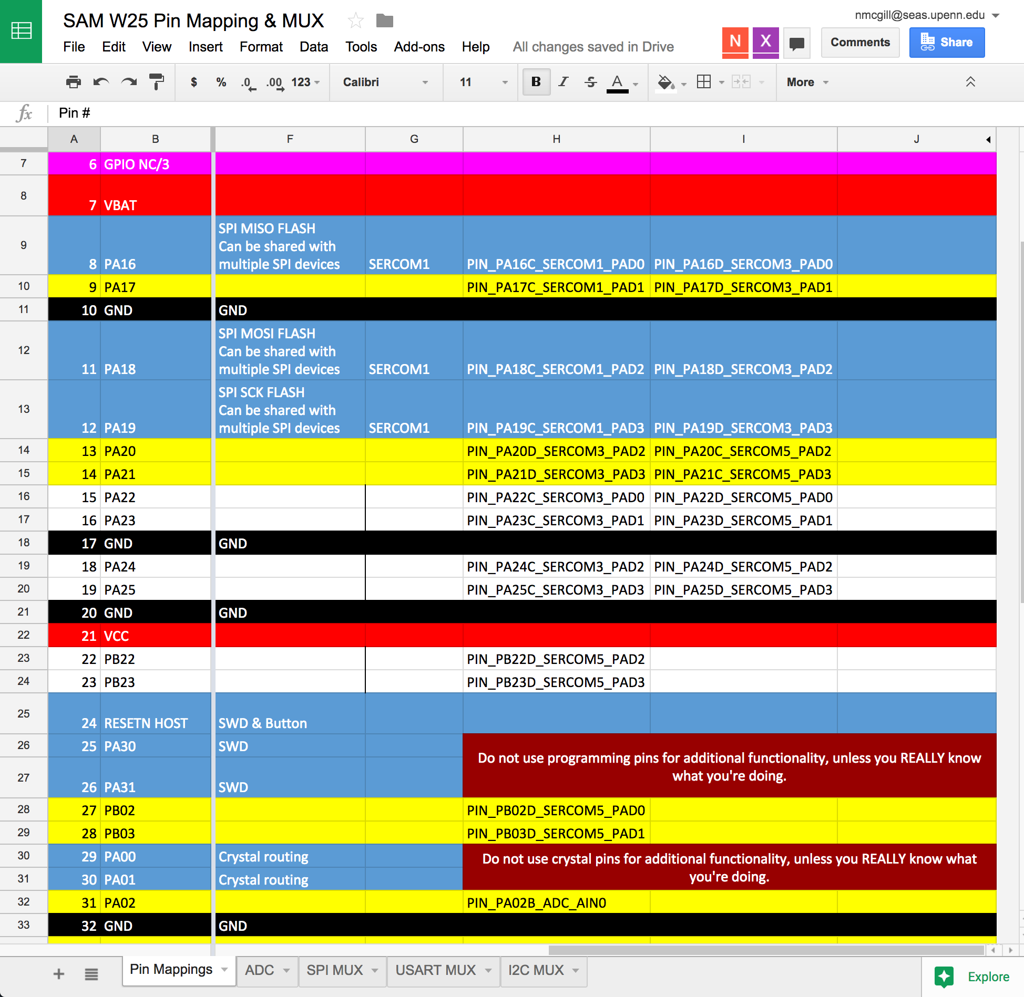
Pin Muxing
Sheets document helping track all of these auxiliary functions
Many pins have two SERCOMs they can operate on
All pins will retain the same PAD#
SERCOM# will have a group of pins that work together
Unsure of your pin mapping?
Read up those datasheets
Check start.atmel.com
More on this next class!

Slide 18
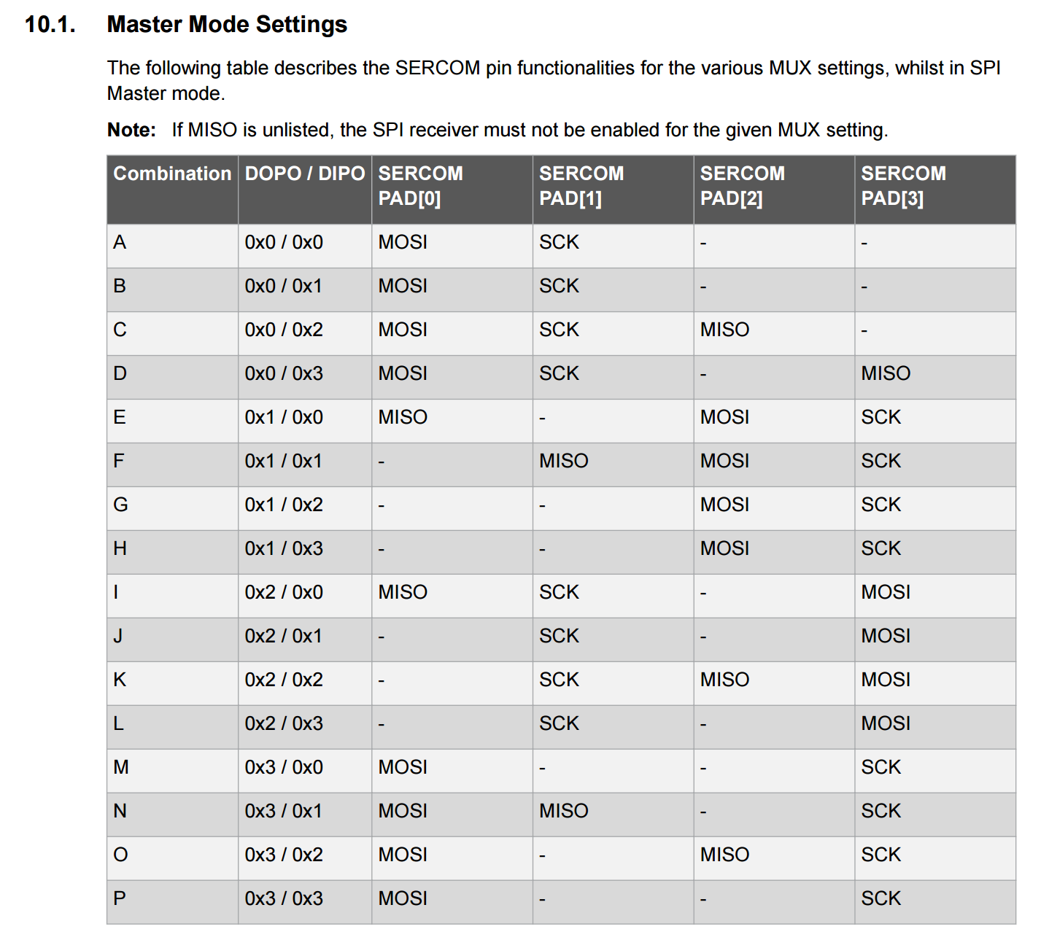
Pin Muxing: SPI
DOPO = Data Out Pin Out
DIPO = Data In Pin Out

Slide 19
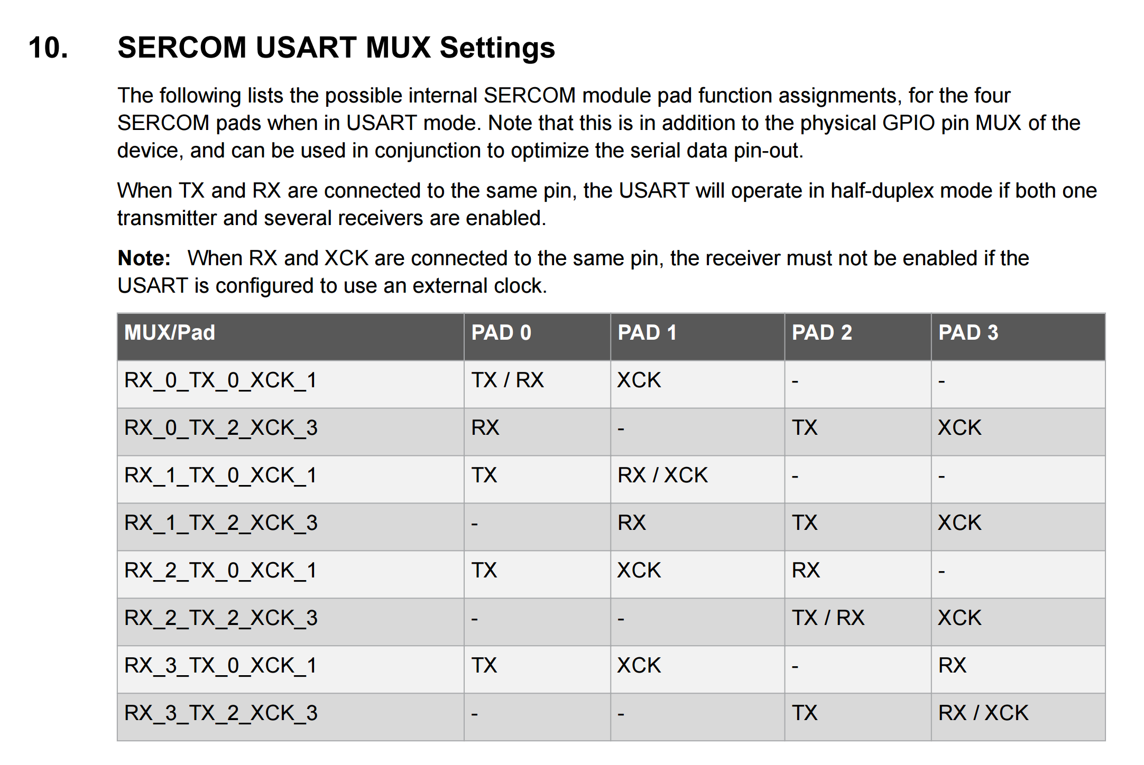
Pin Muxing: USART
If RX & TX are connected, operation is in half duplex
XCK can be used for clock sync
Check special case with RX & XCK sharing pin
For our CLI, we’re going to safely ignore this.
You may have a specific reason for it!
Your CLI UART will be full duplex.

Slide 20
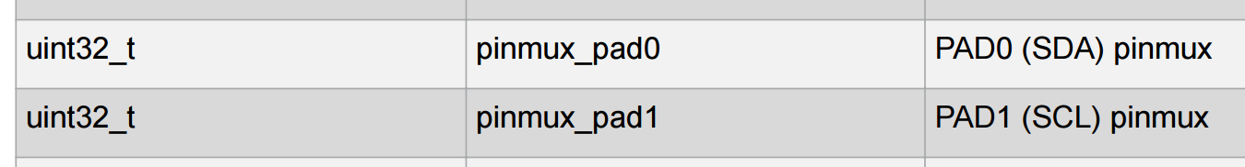
Pin Muxing: I2C
Only one configuration for I2C muxing
PAD0 = SDA
PAD1 = SCL
Other two pads should be declared unused for the SERCOM.
Can be used as a GPIO, ADC, or other non-SERCOM function

Slide 21
L2.0: Atmel Studio & ASF

Slide 22
L2.0: Atmel Studio & ASF
Go through the rest of these slides – read through everything.
Open Atmel Studio and poke around. Get comfortable.
Don’t be afraid to read code. Get to know it.
Use “Find References” on functions to determine their function and routes.
ASF Explorer has APIs and Quick Start Guides for all modules
Comprehension Questions:
Do you understand how to set up a project? Which MCU do you select?
What is an Atmel ICE? Why don’t we need it for your SAM W25 Xplained boards?

Slide 23
Getting started – Exploring the IDE

Slide 24
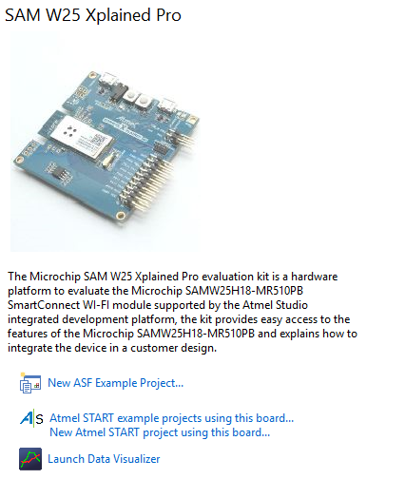
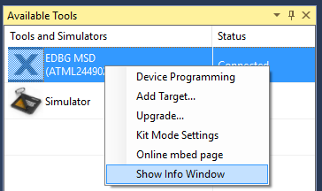
GETTING STARTED
Connect the SAMW25 board to the computed using the USB cable (use the port on the board that says “DEBUG USB”)
Open Atmel Studio
You will be greeted by the Initial SAMW25 greeting page as shown on the left.
If you do not see this, go to “View >> Available Atmel Tools”. A panel should appear – right click “EDBG MSD >> Show Info Window”

Slide 25
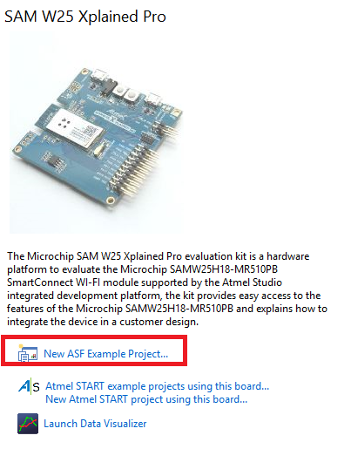
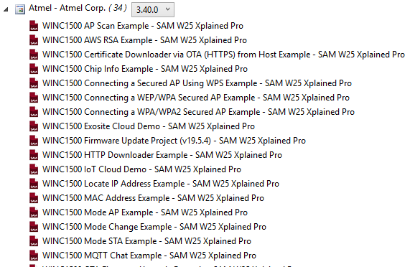
GETTING STARTED
Click on “New ASF Example Project…”
This will load a new window that will show you all the example project related to the WINC1500. As you can see, we have a lot of examples that exercise the Wi-Fi module!

Slide 26
Before GETTING STARTED…
However, before we start we must deal with a reality that is too frequent on embedded systems with Wi-Fi modules…
Most probably, the firmware on your WINC1500 is out of date and must be updated! No worries, the next example will show you how to do this.
This will show you the general workflow of loading a project and running it. We only need to do this process once to upgrade your WINC1500!

Slide 27
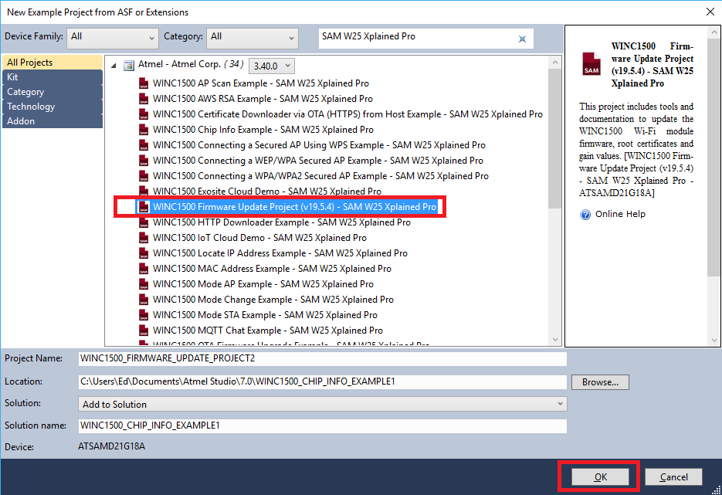
Before GETTING STARTED
Open the example “WINC1500 Firmware Update Project (v19.5.4) – SAMW25 Xplained Board Pro” and hit OK.
Hit “Accept” to any other windows that appear asking you to accept the terms and services.

Slide 28
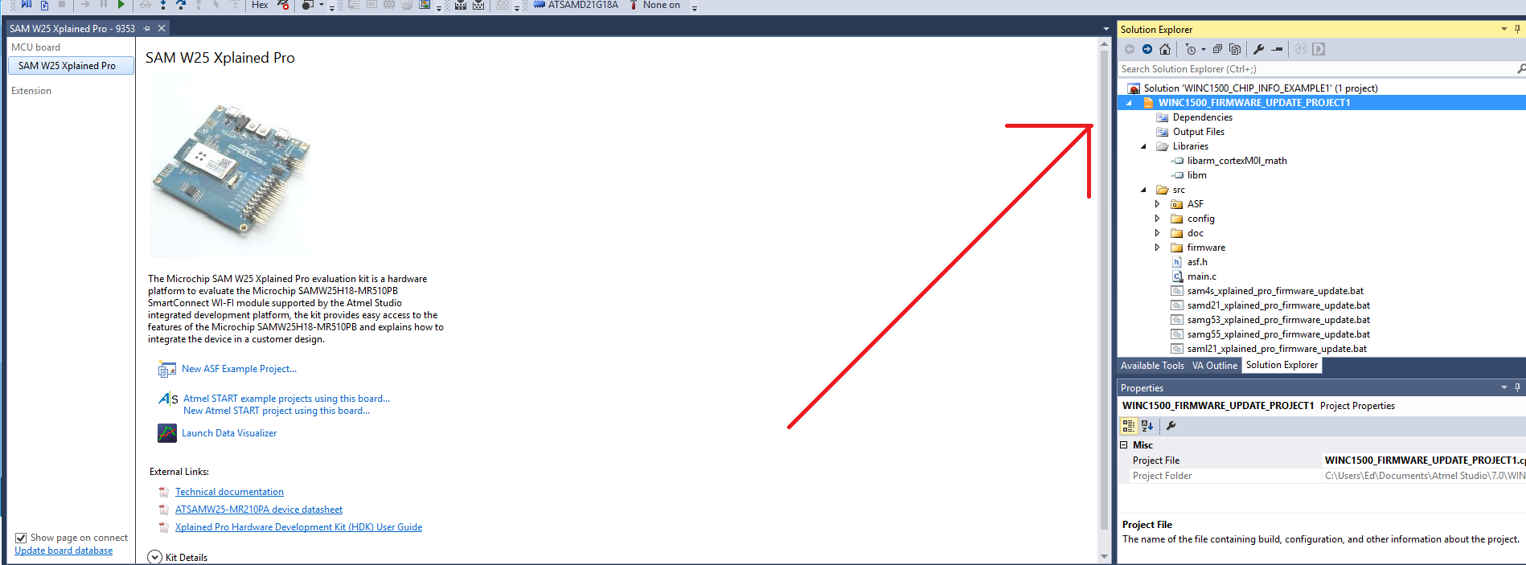
Before GETTING STARTED
The project will be loaded on the solution explorer. You can expand the folders to view the files that comprise the project.

Slide 29
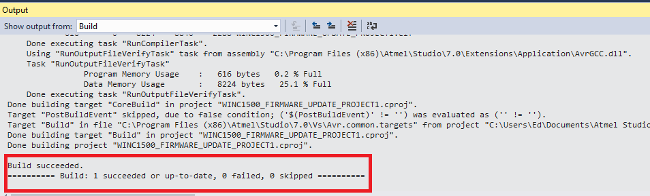
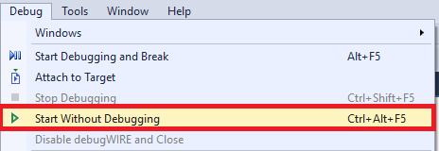
Before GETTING STARTED
Now that we have a project open, let’s load it into the SAMW25 and run it! For now we will only load the code and tell it to run – we will learn how to debug in a later session. This particular code will fail if we run it in debugger mode (the WINC1500 will not be able to update)
To build the code and load it, go to “Debug >> Start Without Debugging”. This will build the code and load it into the MCU. If successful, you will see the “Build succeeded” on the “Output” window.
Note: If you get a window asking you to upgrade the debugger, hit “upgrade” and wait until it finishes, then try the previous step again.

Slide 30
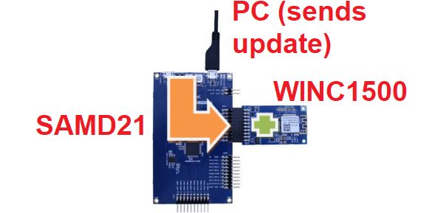
Before GETTING STARTED
Now you have a program running! The previous method shows you how to open a project and load it into an MCU. Before we continue to more exiting stuff, we need to finish upgrading the WINC1500
What we just did was upload a program that will allow us to upgrade the WINC1500. It is a program that turns the SAMD21, our MCU, into a communication bridge between our PC and the WINC1500

Slide 31
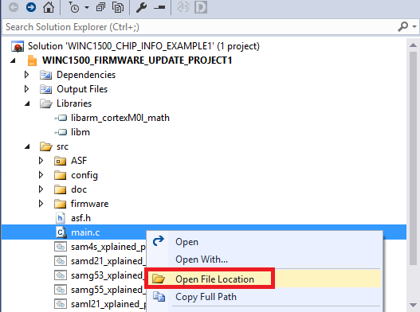
Before GETTING STARTED
Now, search for “main.c” on the Solution Explorer and right click it. Select “Open File Location”
This is a good way to find where your project files are!
We need to run the batch file “samw25_xplained_pro_firmware_update.bat” to send the update. Double click this file. A CMD window should appear and take ~20 seconds outputting tests.

Slide 32
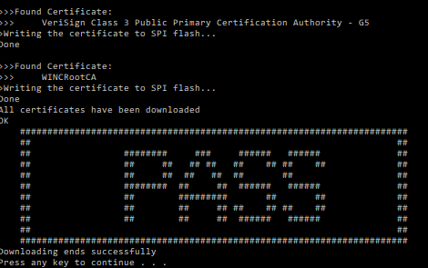
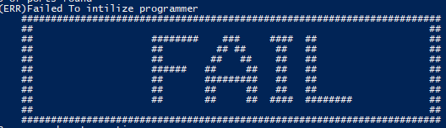
Before GETTING STARTED
IF YOU SEE “PASS” – Continue!
IF YOU SEE “FAIL” – Call me or call TAs!

Slide 33
Winc1500 updated hopefully we never have to do that ever again

Slide 34
Running an winc example – debugging and breakpoints
If you are familiar with IDEs, proceed to next section.
However, the example we are using here might be of use for later assignments...!

Slide 35
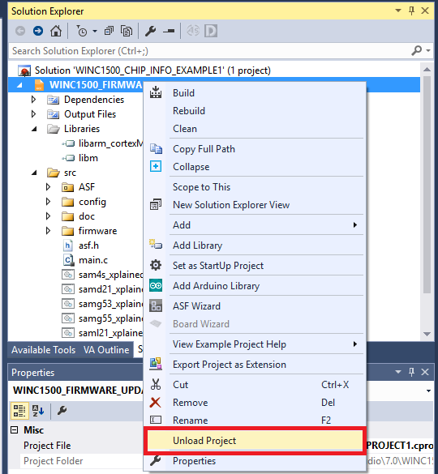
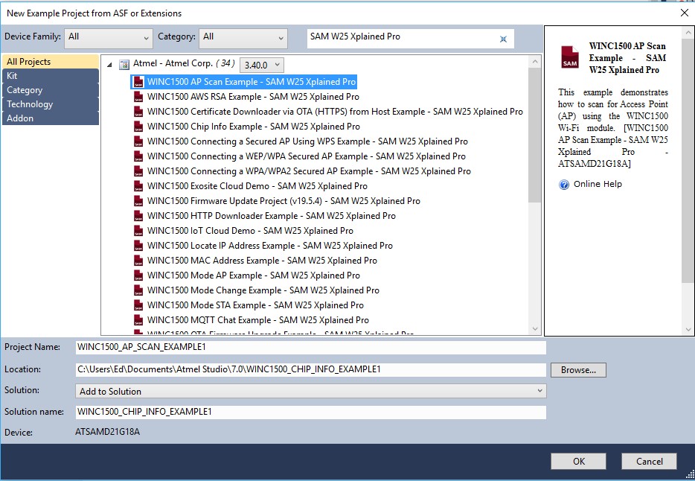
Running a winc1500 example
Unload the “Firmware Update” project (right click on Project and do “Unload Project”.
You can also just remove it by doing “Right Click >> Remove”
Go back to the “SAMW25” examples and choose the “AP Scan Example”

Slide 36
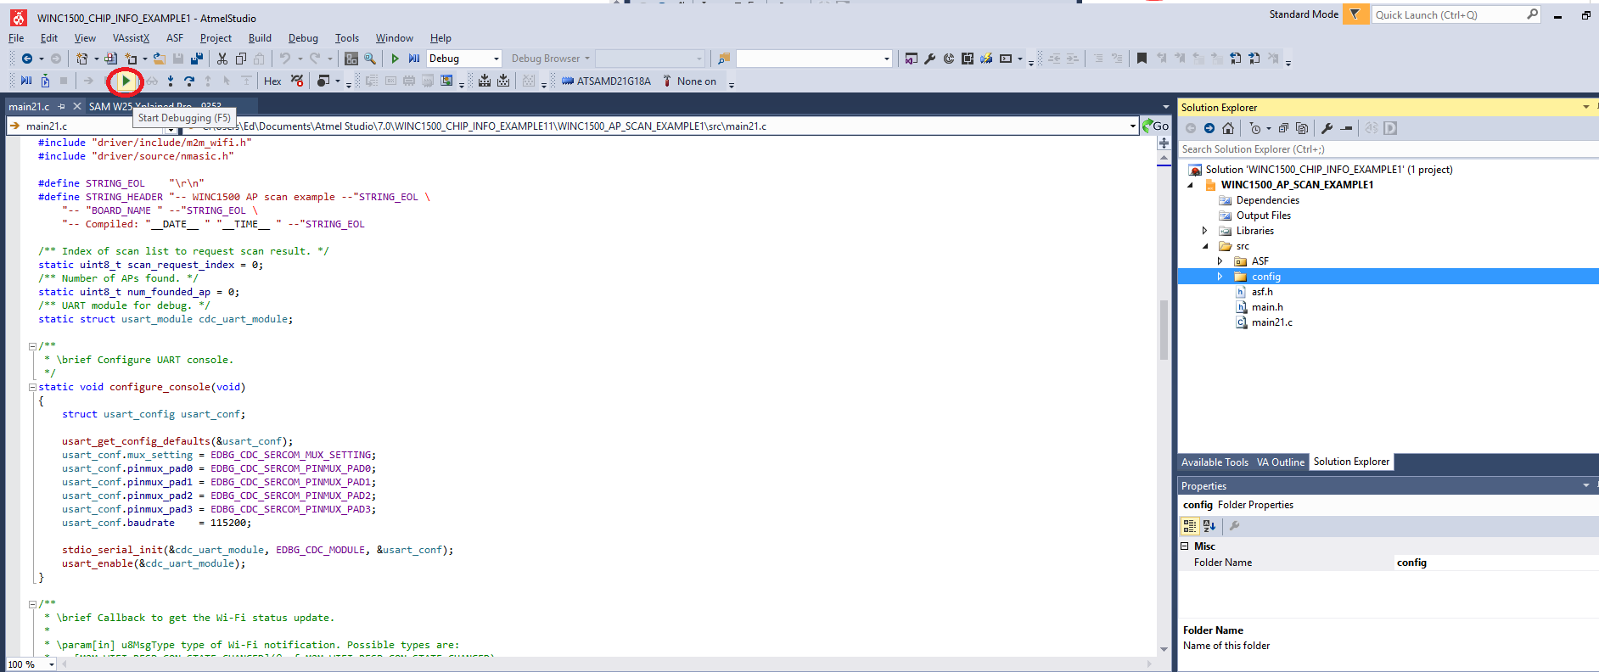
Running a winc1500 example
Let’s run the code in debug mode and see what it does! Hit the “Debug” arrow on the top toolbar (or press F5). The IDE will compile and upload the code into the SAMD21

Slide 37
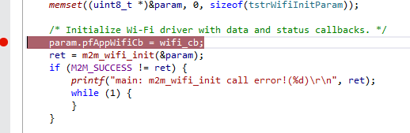
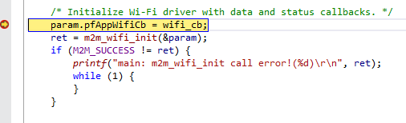
Running a winc1500 example – How to set a breakpoint
The code will upload and instantly start running – You can tell by the status bar at the bottom that says “running”!
Let’s set a breakpoint and reinitialize the device. Open “main21.c” and on line 250 click on the left-column beside the code. A red dot, symbolizing the position of the breakpoint, will appear.
On the debugging toolbar, hit “Reset” (Shift + f5) and then “Continue” (f5). The debugger must have hit the breakpoint. The yellow arrow indicates the current position of the MCU on the code.

Slide 38
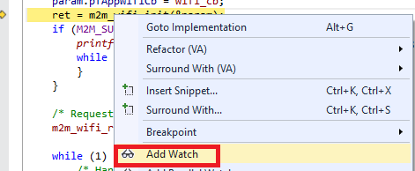
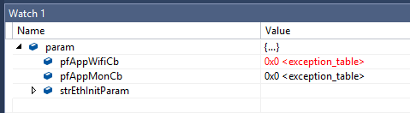
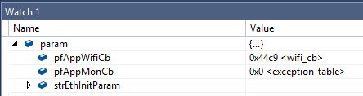
Running a winc1500 example – How to watch a variable
To watch a variable, right click on a variable name and hit “Add Watch”. This will add them to the watch window, where you can see their value change as you progress through the code.
For example, add the variable “param” and put a breakpoint on line 250. Restart the code. Watch as the variable is assigned a value on lines 250-251
You can also change the value of a variable – good for debugging (sometimes)
Line 250
Line 252

Slide 39
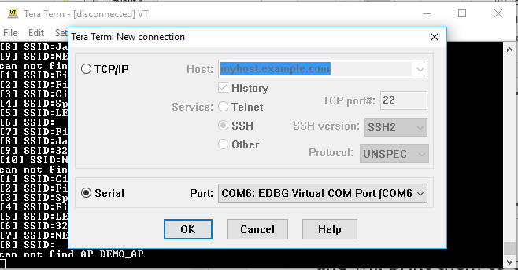
Continuing with a winc1500 example
Let’s continue with the example. As you can read in the comments, this example scans for APs (Internet Access Points) and will print them to the UART.
To read the uart, open a terminal program (like TeraTerm) and set it up to listen the COM por of the SAMW25 board (in this case, it is COM6)

Slide 40
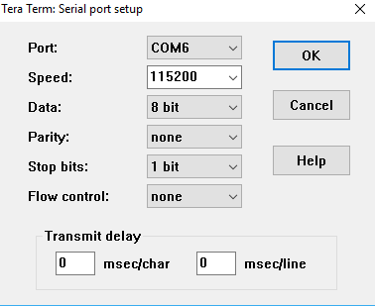
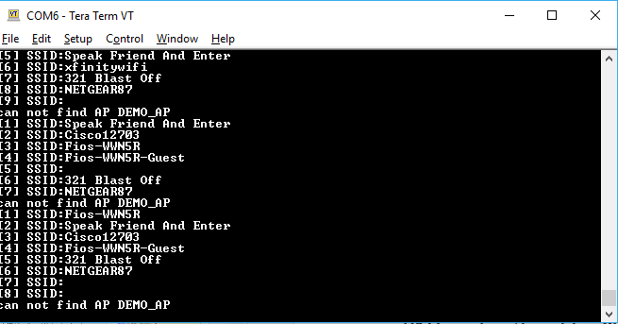
Continuing with a winc1500 example
Once TeraTerm is open, we need to set it up to the same BAUD RATE as the example uses – this is 115200 8N1
8N1 is shorthand for “8 bit data, no stop bit, one parity bit – a old timey notation! More on 8N1 notation
Once set up, you should be able to see APs being displayed on the console!

Slide 41
MAKING YOUR OWN PROJECT FOR THE SAMW25 DEV BOARD

Slide 42
Making a blank project for the samw25 dev board
You can also make you own project for the SAMW25 Dev board
This takes into advantage the mapping of the physical board – It has a Board Support Package (BSP) that designates MCU pins to the hardware on the system (example – GPIO to LEDs on board, UART to on board EDBG bridge, etc).
Later in the course we will see how to do a project for a completely custom board, such as the one you will be doing

Slide 43
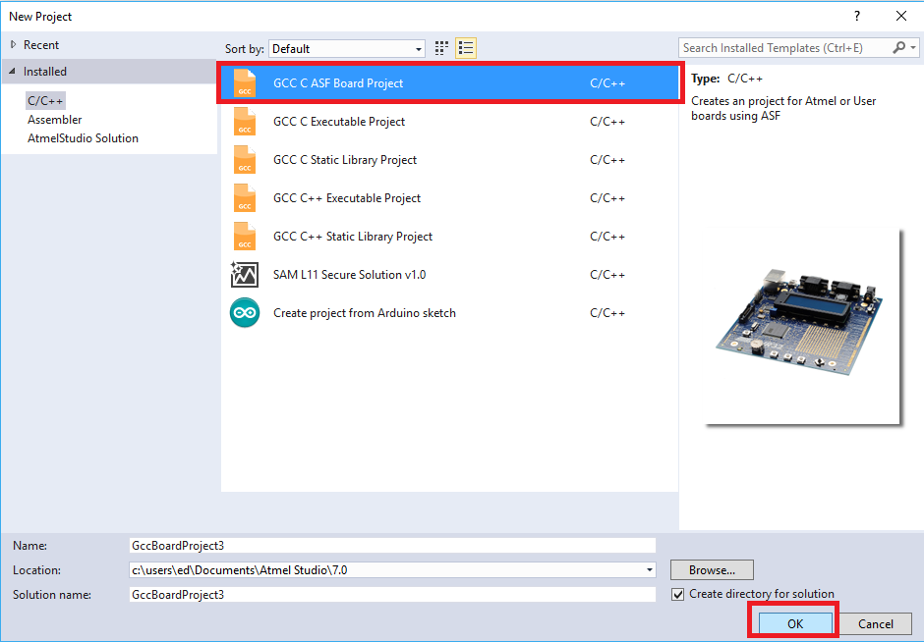
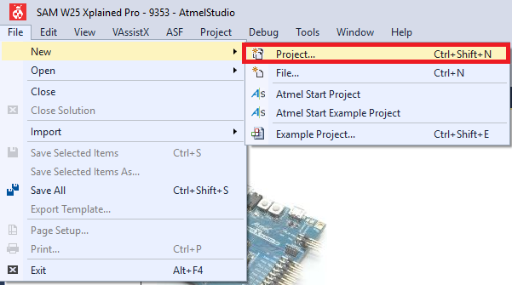
Making a blank project for the samw25 dev board
Click on “New >> Project…”
Choose “GCC C ASF Board Project, give it a name and location, and hit “Ok”

Slide 44
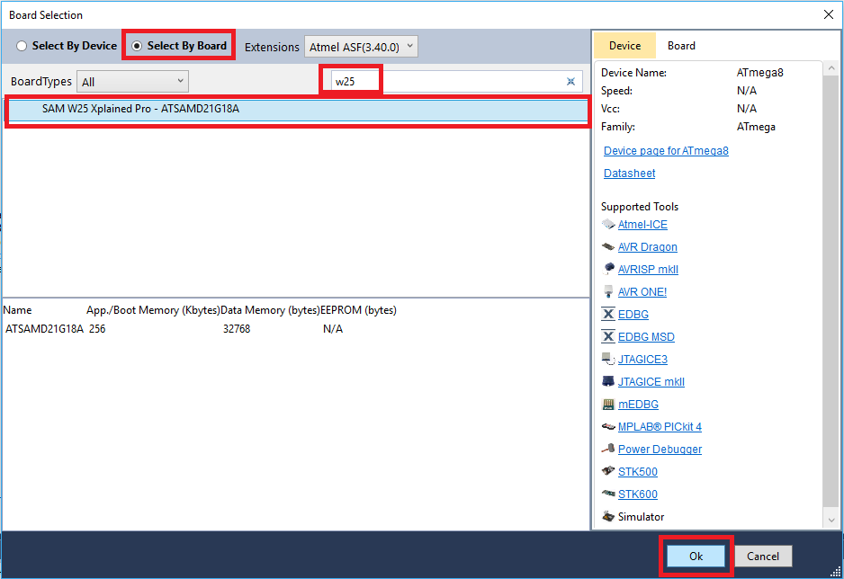
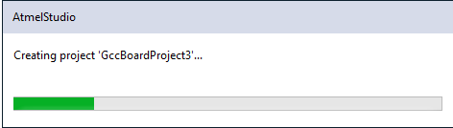
Making a blank project for the samw25 dev board
Choose “Select by Board” to show options based on Atmel Dev Boards
Search for “w25”
Select “Sam W25 Xplained Pro – ATSAMD21G18A” and hit “Ok”. Atmel Studio will create a project

Slide 45
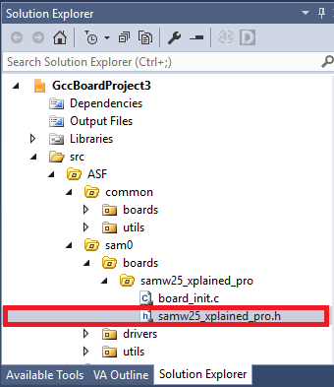
Making a blank project for the samw25 dev board
You will now have a blank project with very basic code to start with. Now, explore “main.c” and get familiar with what is done:
- What does “system_init()” do? Where is it defined?
What does the code in the while loop in main do?
Go to “src >> ASF >> sam0 >> boards >> samw25_xplained_pro >> samw25_xplained_pro.h”. What does this file do?

Slide 46
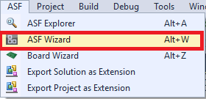
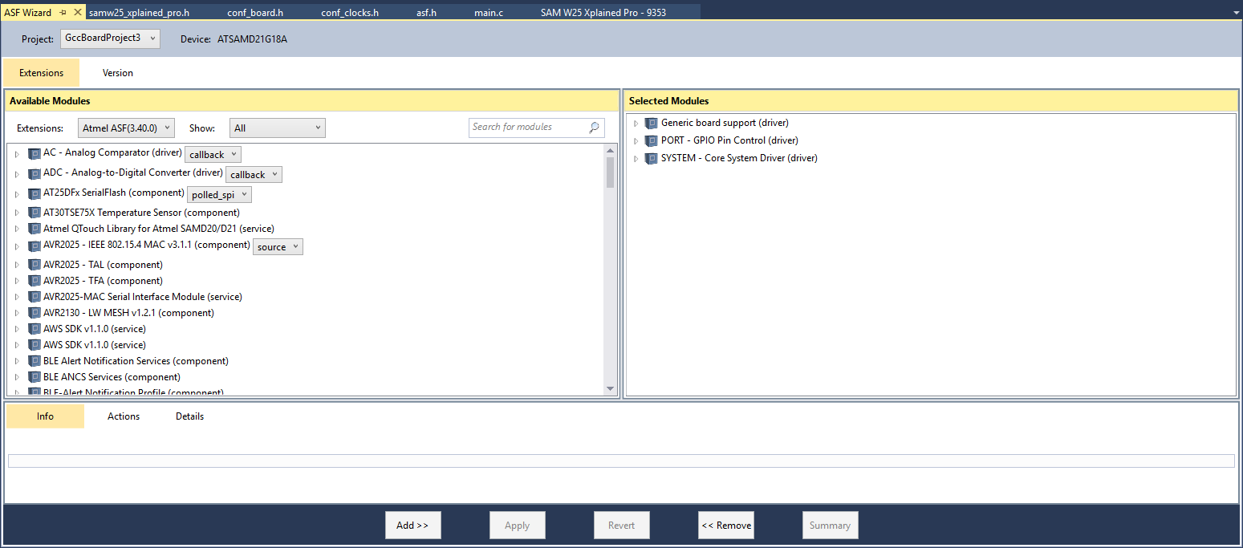
Adding asf modules to your samw25 dev board project
Now that we have a blank project, let’s add ASF modules to it!
Go to “ASF >> ASF Wizard”. This will open a window that will show all the ASF modules available for your platform (left) and the modules that are currently present in your project (right). Take some time to go through and read the modules ASF has for you.

Slide 47
Finding examples for asf modules you just added
Microchip has multiple examples as well as API documentation online:
http://asf.atmel.com/docs/latest/samd21/html/index.html
This will be one of the best resources for you in this class!
To learn more about the UART driver we just added, read http://asf.atmel.com/docs/latest/samd21/html/group__asfdoc__sam0__sercom__usart__group.html#asfdoc_sam0_sercom_usart_special_considerations
Implement the example mentioned on the following page in your project
http://asf.atmel.com/docs/latest/samd21/html/asfdoc_sam0_sercom_usart_callback_use_case.html

Slide 48
Finding examples for asf modules you just added
Read the previous example code and understand what it tries to do.
Open a terminal program, like TeraTerm, and play with the example
Comprehension questions
How many characters does it need before it replies a response?
Does this example allow for the device to perform other tasks in the meanwhile? Is it blocking?
How would you change it to make the system non-blocking?

Slide 49
Conclusion
As you saw in the previous slide, finding toy examples and trying them out is a very common step in integrating new ASF modules into your code and making them work!
The LAB0 assignment will be your fist programming challenge in this class and will be a warmup for the A1 assignment – the Command Line Interface

Slide 50
Office Hours
We’re finishing choosing these. Most likely a Wednesday + a weekend.
These will also be on the class calendar.
Keep using Piazza! Great community being developed already.

